Slide 1
THE CONTRIBUTION OF BODY CENTER OF MASS VELOCITY TO BASKETBALL BALL RELEASE VELOCITY ACROSS SHOT DISTANCES
Casey Wiens¹ and Jill L. McNitt-Gray^{1,2} Departments of Biological Sciences¹ and Biomedical Engineering² University of Southern California Los Angeles, United States of America

Slide 2
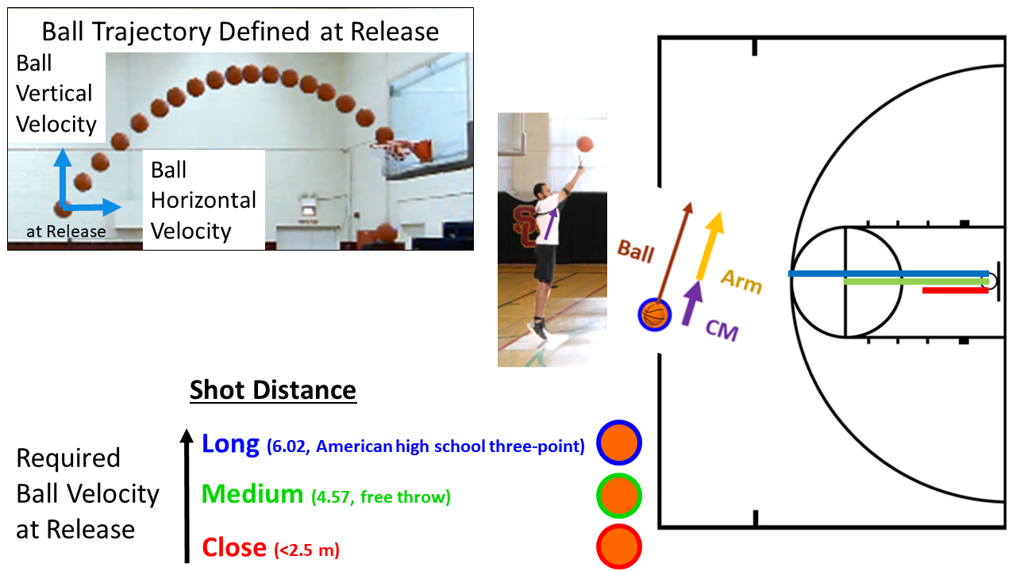
Mechanical Objectives of a Basketball Shot
Determinants of Success
More than one trajectory can result in success from same ball position
Ball velocity at release is determined by (Hay, 1978):
Body center of mass velocity
Velocity of ball relative to the body center of mass
Contributed to the arms
Center of mass vertical velocity increases with increase in shot distance
Miller and Bartlett, 1993
Okazaki and Rodacki, 2012

Slide 3
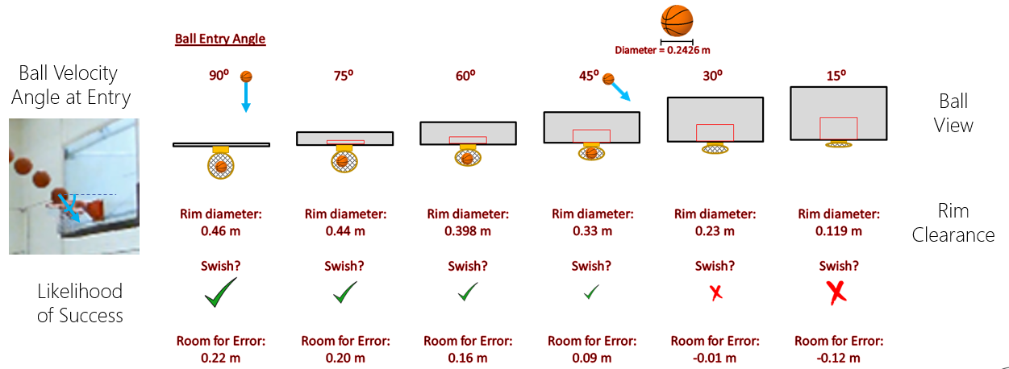
Increased Ball Vertical Velocity at Release Increases the Likelihood of Success

Slide 4
Does the Increase in Center of Mass Velocity at Release Reduce the Arm’s Contribution to Ball Velocity?

Slide 5
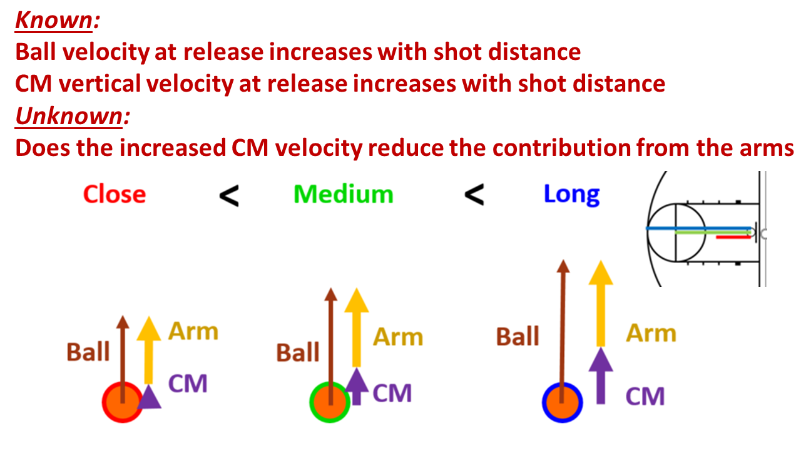
How Does CM Velocity Contribute to Ball Velocity at Release with Increases in Shot Distance?
Hypothesis
The greater the CM velocity at release, the greater % contribution CM velocity to ball velocity at release

Slide 6
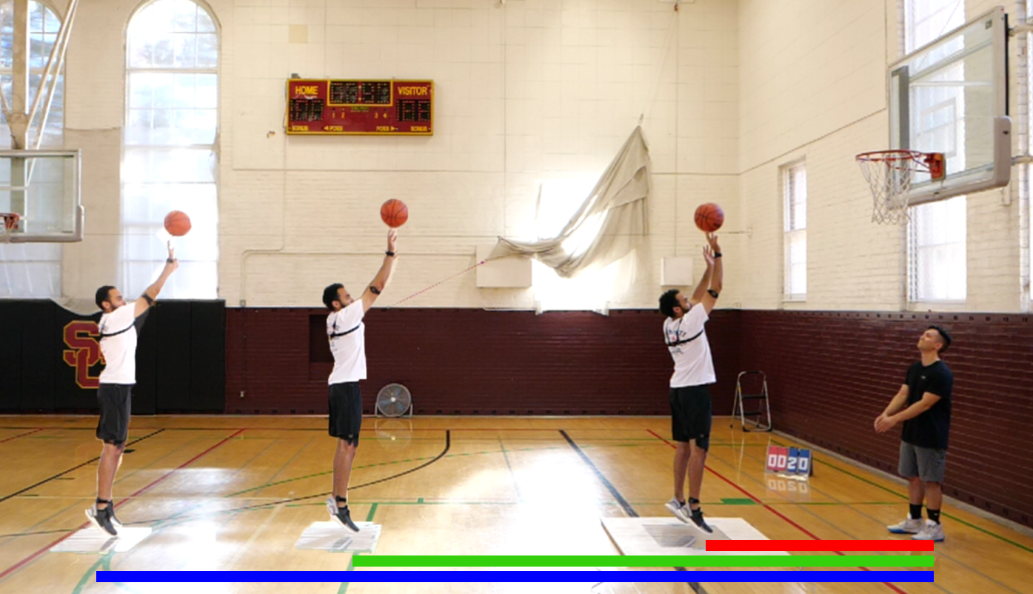
Methods
Participants
7 recreational players
4 female
College aged
Basketball Shot at Game Pace
10 attempts from each distance
Started from static position on plates
Received pass from person under hoop
Motion Capture
Ball motion
Panasonic, 120Hz
Force-Time Characteristics
Net impulse
Kistler, 1200Hz

Slide 7
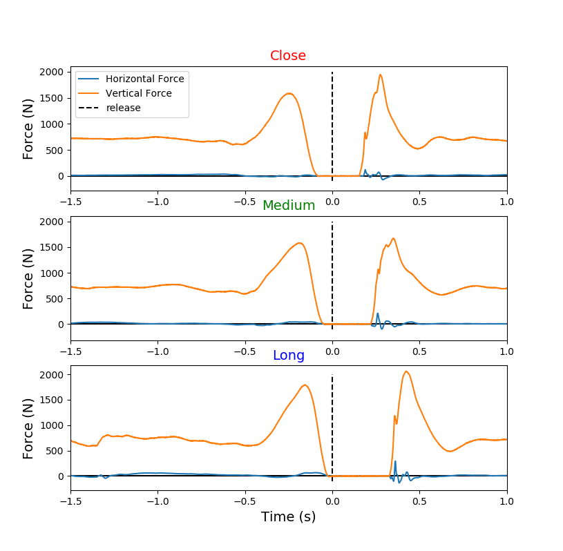
Center of Mass Velocity Determined using Forces
Net Impulse
Integrate during shot prep
Time 1: Fz = BW +/- 10 N and Fx & Fy = +/- 30 N
Time 2: ball release
Velocity
Change in Velocity = Impulse
Assumed began at 0 m/s

Slide 8
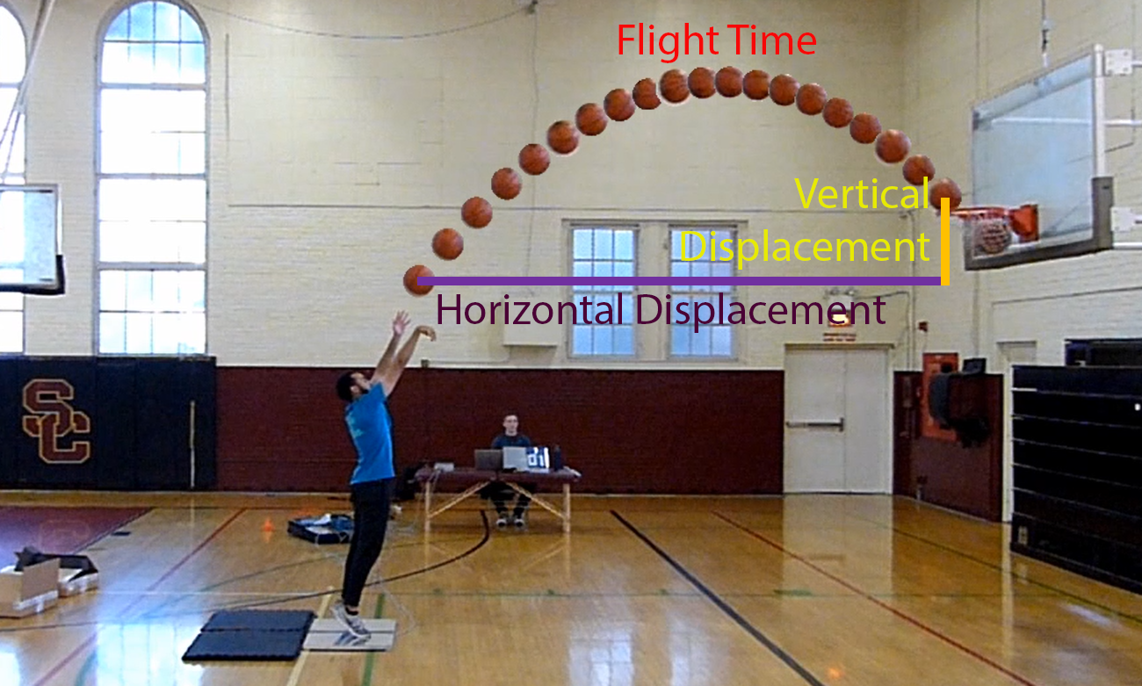
Ball Velocity at Release Determined by Flight Time and Ball Trajectory

Slide 9
Does a Greater CM Velocity at Release Contribute More to Ball Velocity at Release?

Slide 10
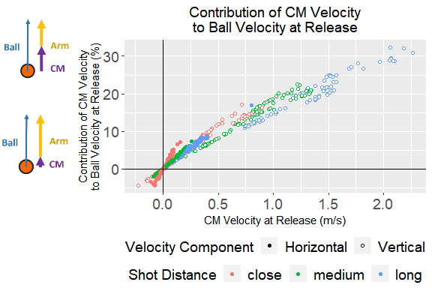
Results: If You Have It, You Use It
With greater shot distance, a greater ball velocity at release is needed
Having a greater CM velocity at release increases its contribution to ball velocity at release
This reduces the contribution required from the arms

Slide 11
How Can You Achieve a Greater CM Velocity at Release?

Slide 12
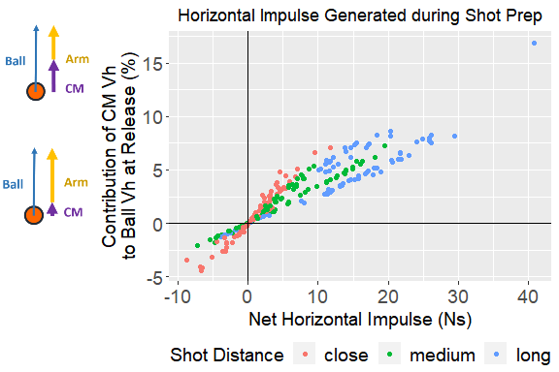
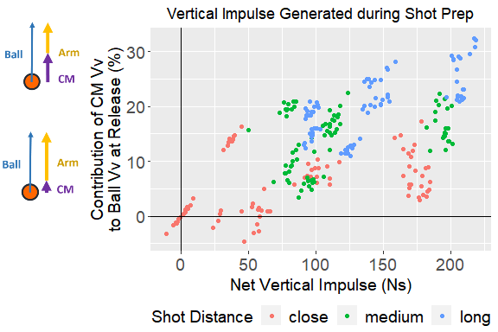
Generating Greater Impulse during Shot Prep Affords Greater Potential for CM Velocity at Release

Slide 13
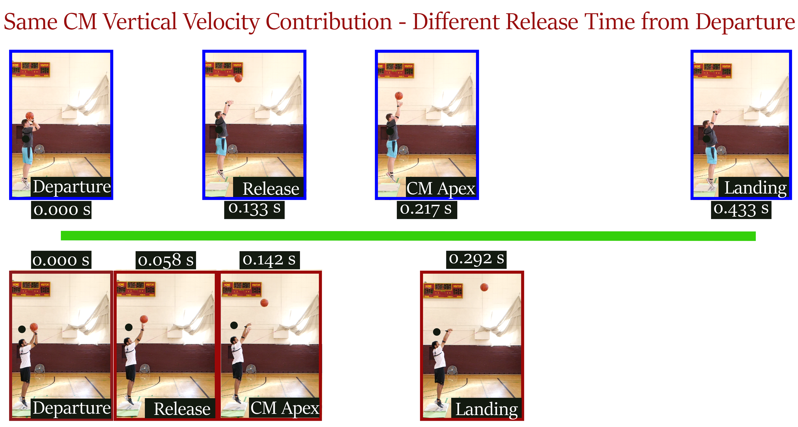
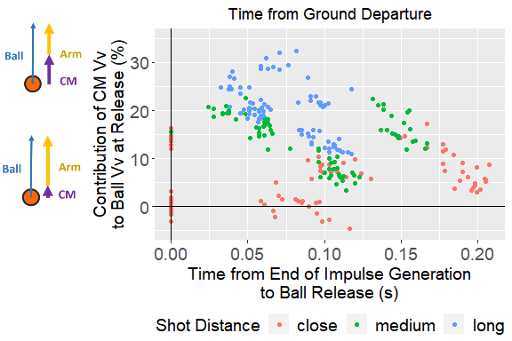
Time of Release Relative to End of Impulse May Not Give Full Picture

Slide 14
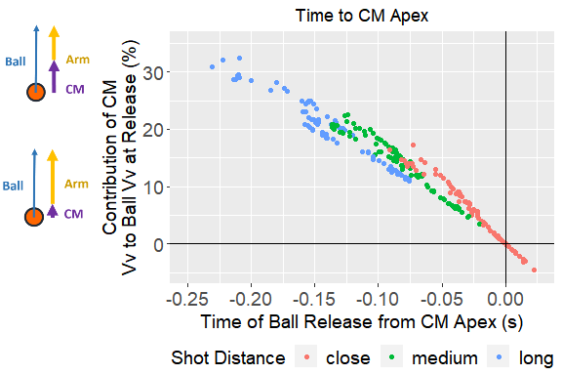
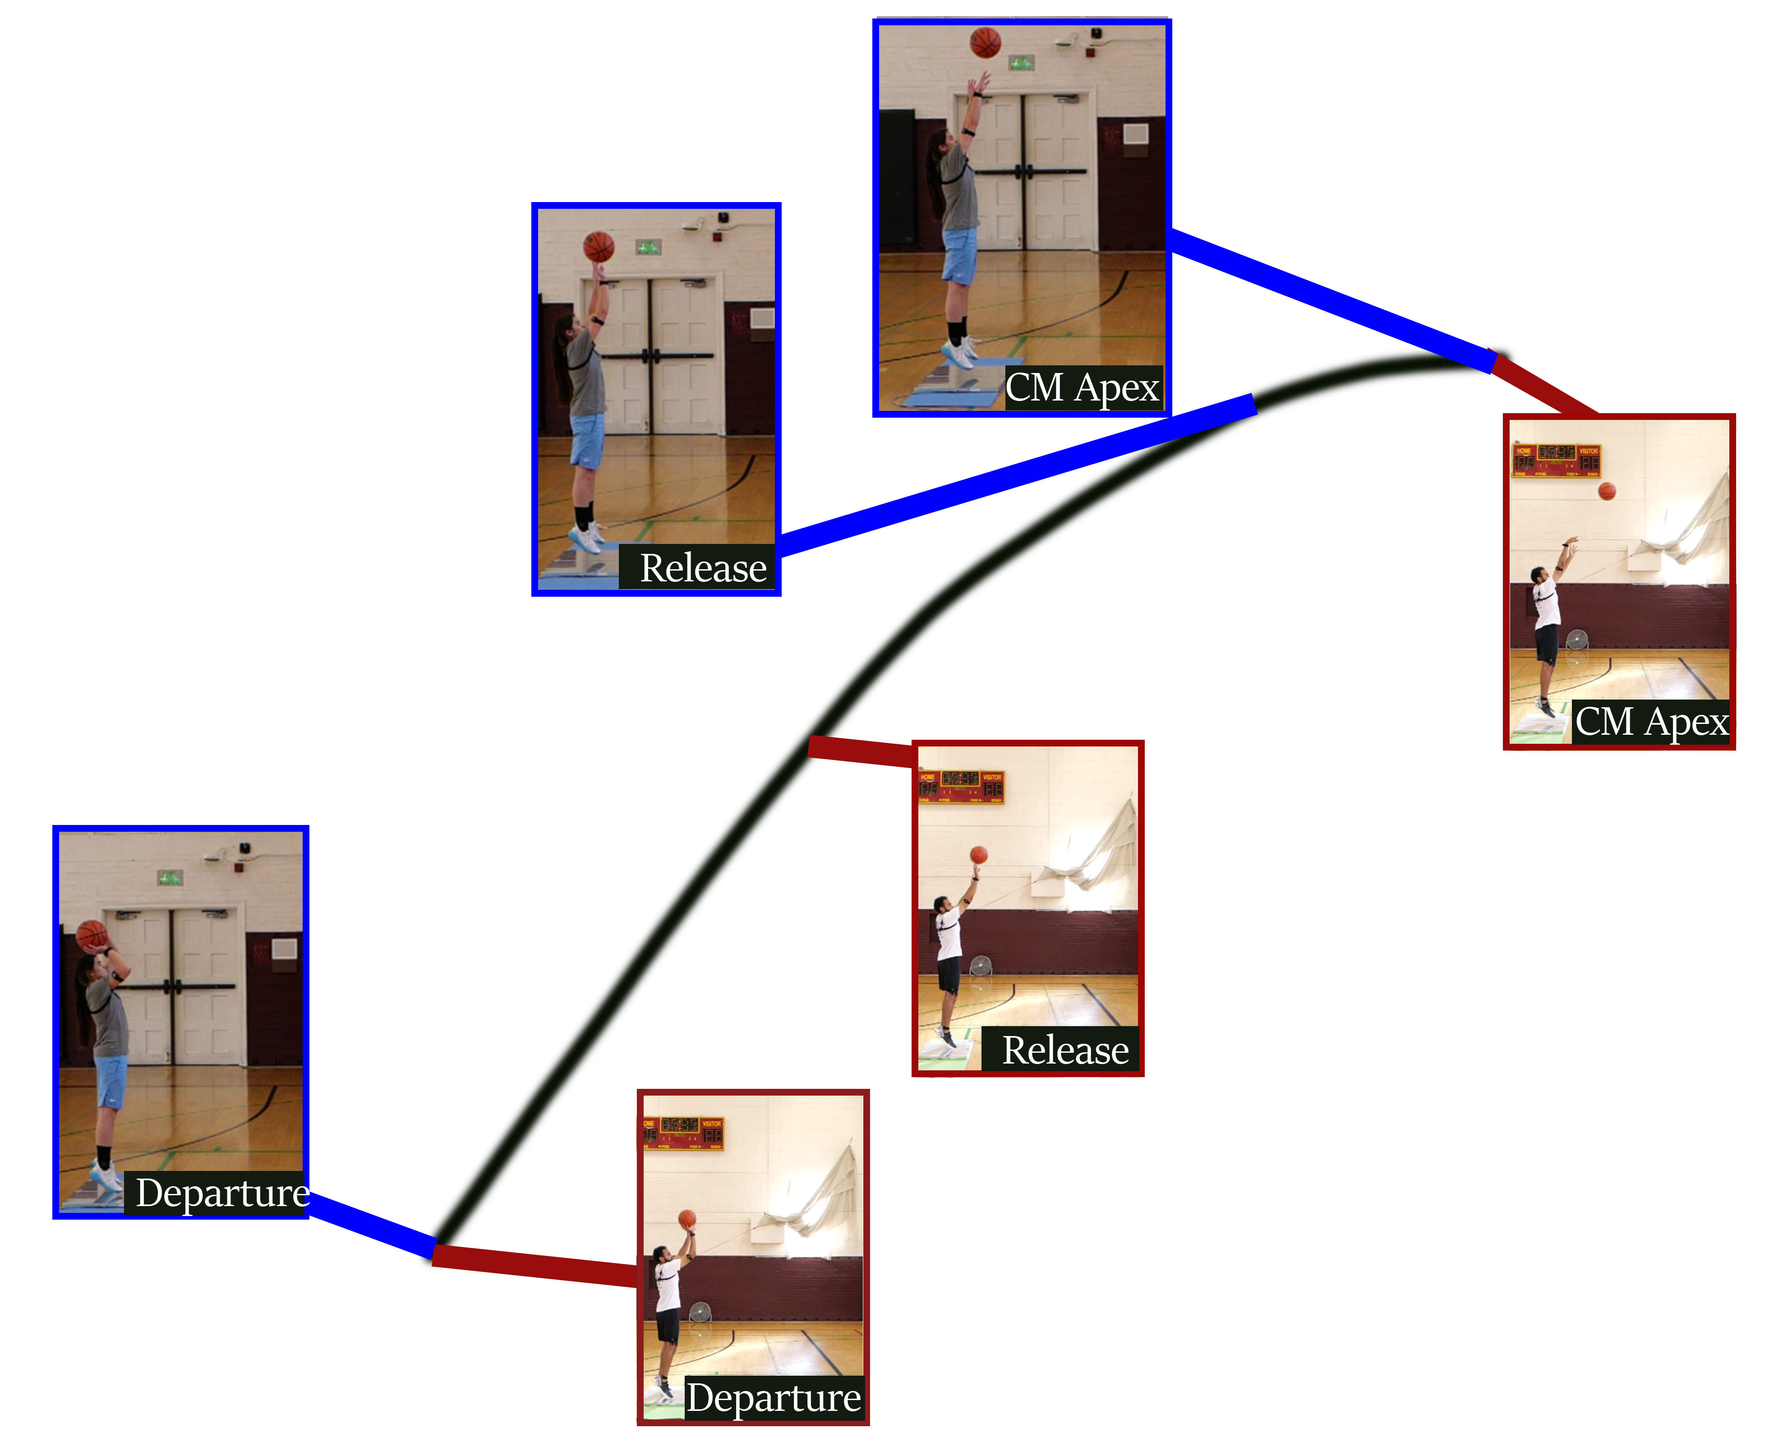
Releasing the Ball Earlier Relative to the CM Apex Trajectory Increased the Contribution of the CM Vertical Velocity to Ball Vertical Velocity at Release

Slide 15
Discussion
Increase in shot distance increased CM velocity contribution to ball velocity at release
Arm contribution decreased
As CM vertical velocity contribution to ball vertical velocity increased:
Ball was released earlier relative to apex of body CM trajectory
To increase CM velocity available at release:
Increase impulse generated during contact phase
Future directions
Increase sample size
Increase range of shooting skill level
Within-participant analysis
CM trajectory contributions to shooting accuracy
Effects of shooting while defended

Slide 16
Limitations
Method to Calculate Velocity
May not be at 0 m/s at initial
Not normal shooting mechanics - usually involves a step in
Small sample size
Population used in study

Slide 17
Future Steps Preview

Slide 18
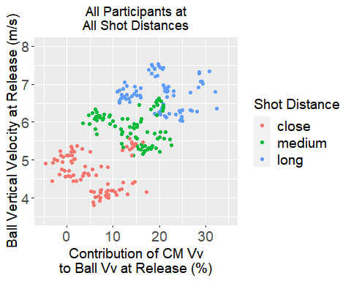
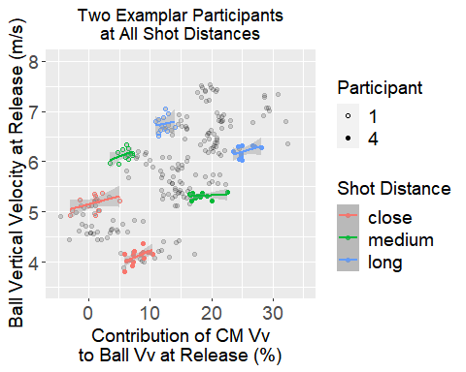
Individual Analyses

Slide 19

Acknowledgements

